Slide 1












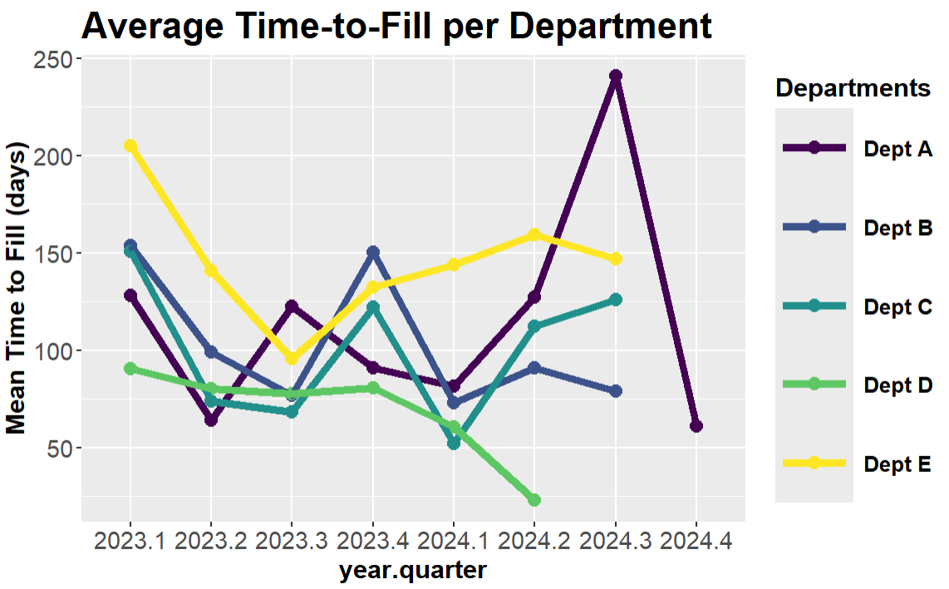




Click here to add title
Workforce Analytics: Visualizing Trends by Department
Carine Wong
Lawrence Livermore National Laboratory, NNSA-MSIIP, University of California - Davis
INTRODUCTION
METHODS
OUTCOMES
FUTURE DIRECTIONS
As the fiscal year here at LLNL comes to an end, departments are analyzing fund allocations and year recapitulations.
While organizational health metrics are available for the entirety of the ES&H directorate, workforce data within ES&H is not broken down by department for analyses.
Workforce data analyses are critical to employee retention, fund allocation, and the effective implementation of management strategies.
To support ES&H managers’ decision-making, we developed five organizational health reviews in a two-year lookback to understand each department’s trends.
We visualized statistics (e.g. time-to-fill) per department over time and compiled them into concise briefings.
Challenges:
Data availability
Receiving data from various program managers takes time
Limited access due to personally identifiable information
Employees are tracked by their payroll but not by their matrix
Variability in data formats
Multiple databases and customers
Every department formats their data differently
Data manipulation
Insufficient tracking → fewer data points
Unique nature of certain data limits our ability apply certain natural language processing (NLP) methods
Small data sets → can’t train own model
Lack of pretrained model available specifically for HR data
Changes in organizational structure → impacts applicability of analyses
Successes:
Presented workforce metrics in a department-specific view to managers—those with direct influence
Created meaningful visualizations that illustrate thematic successes and strengthen team dynamics
Created a mechanism to foster proactive, data driven discussions to develop workforce strategies
Fine tuned data tracking methods based on challenges identified throughout process
Furthered knowledge on statistical methods
Facilitate Organizational Health Reviews for ES&H managers annually
Collaborate with area managers in strategic planning
Develop a live dashboard viewable by ES&H payroll, functional area, and department managers
Scale our analyses laboratory-wide
Identify KPIs to capture areas of focus
Collaborate with dept managers and obtain data
Conduct and compile data analyses
Present findings to ES&H department managers
The areas of focus for our analyses are divided into categories “Get”, “Keep”, and “Grow”:
Hiring metrics
Onboarding
Retention
Transfer/exit feedback
Culture survey
Employee engagement
Development
Workforce availability
Succession planning
Rewards and recognition
Methods used:
Quantitative data (R)
Graphing
Text data (Python)
Sentiment Analysis
Key phrase extraction
Get
Keep
OBJECTIVES
IMPACT
Our project outcome is to create five organizational health reviews for each of the departments within ES&H:
Highlighting progress and successes
Identifying areas of improvement
Pulling organizational health metrics into comprehensive summaries for managers
Our overall goal is to provide a data-driven perspective of organizational health to help managers:
Formulate forward-looking management strategies tailored to each department’s specific needs
Reassess needs for the next fiscal year’s fund allocation
Acknowledge teams’ successes and enhance team dynamics
Grow
People are our number one asset: by objectively analyzing and identifying areas for improvements, we can support managers implementing improvement processes in workforce strategies. ES&H is connected to every part of LLNL, and it is imperative that we promote a sustainable, safe, and healthy workplace for our departments and for others.
ACKNOWLEDGEMENTS
Special thank you to my mentors, Julie Fregoso and Anthony McKenna, for their unwavering support and guidance throughout my time here at LLNL.
Thank you to Mark Mitchell and our points of contact at ES&H for their help and input.
Thank you to the NNSA-MSIIP team for providing this invaluable opportunity for learning.
This research was performed under an appointment to the Minority Serving Institutions Internship Program (MSIIP) administered by the Oak Ridge Institute for Science and Education (ORISE) for the National Nuclear Security Administration (NNSA) and the U.S. Department of Energy (DOE). ORISE is managed by Oak Ridge Associated Universities (ORAU). All opinions expressed in this paper are the author’s and do not necessarily reflect the policies and views of NNSA, DOE, ORISE, or ORAU.
Figure: example visualization of time-to-fill (posting to offer acceptance) per department over FY23 and 24
LLNL-POST-867299
This work was performed under the auspices of the U.S. Department of Energy by Lawrence Livermore National Laboratory under Contract DE-AC52-07NA27344.
Notes:
Language - final
Organizational Health Reviews briefings
Workforce Data – raw numbers/reports/list
Workforce Metrics – rates, percentages, stats
Workforce Analytics – so what. How does compare, what is it telling us.
Management Strategies

